Slide 1
Oracle Management Cloud & Dyn: Increased Perimeter Protection & Internal Visibility
Presenter: Dan Brett, Security Team

Slide 2





Dyn Web Application Firewall (Logs)
Oracle Management Cloud
Mary Baker
Marketing Executive
Remediation
Log Analytics
Security Monitoring & Analytics

Slide 3
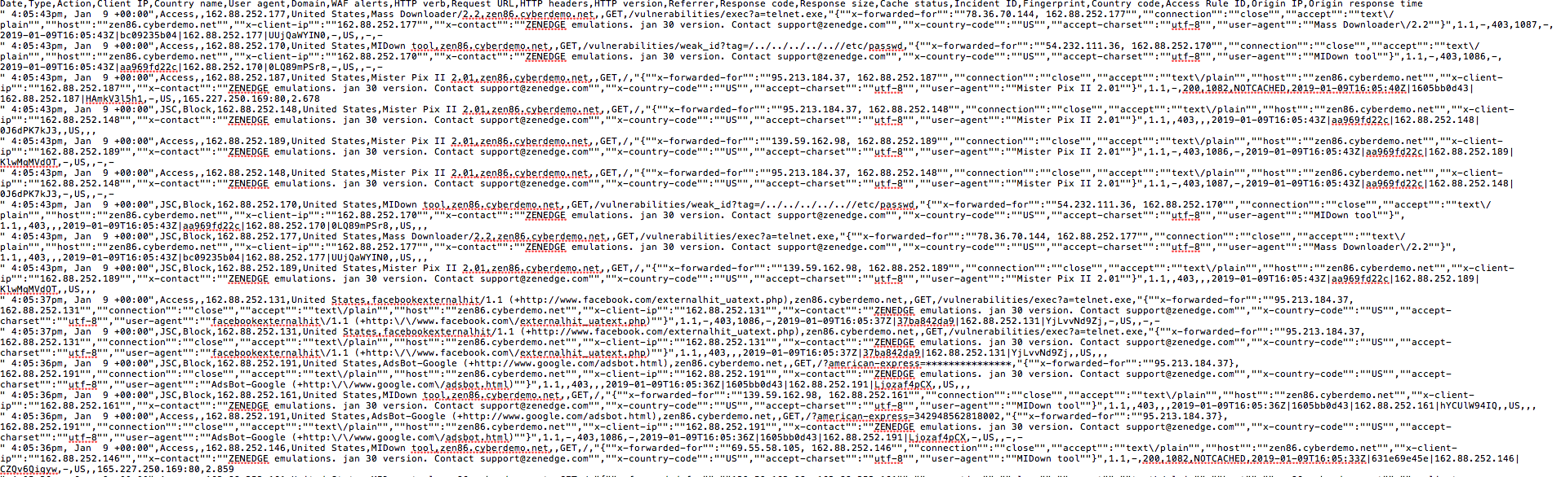
Sample Dyn WAF Logs

Slide 4
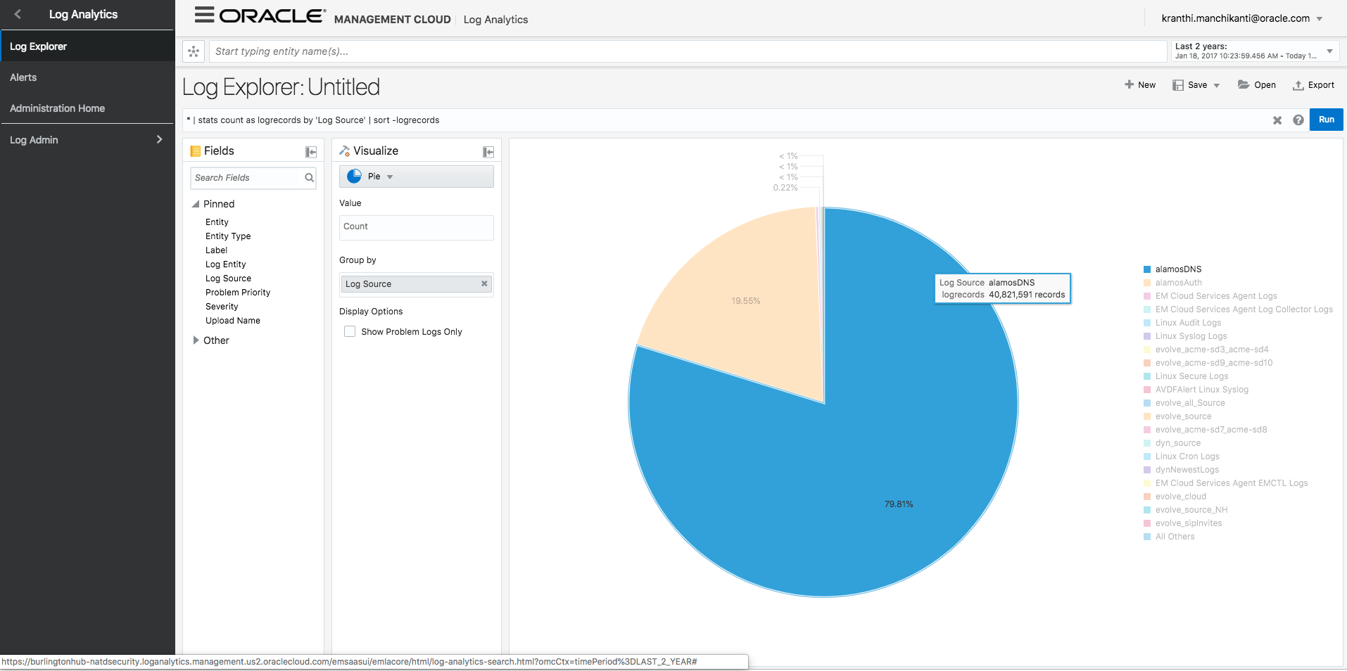

Slide 5
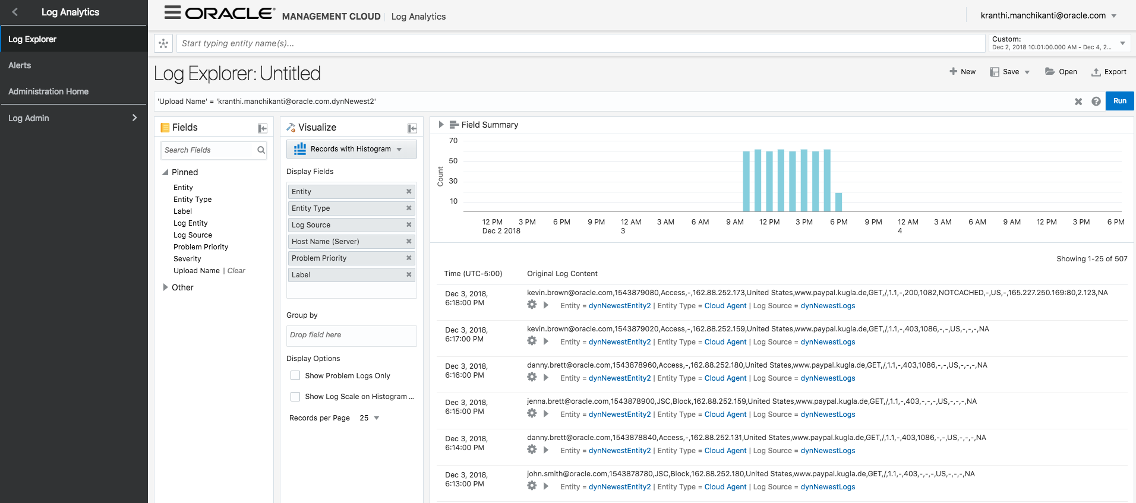

Slide 6
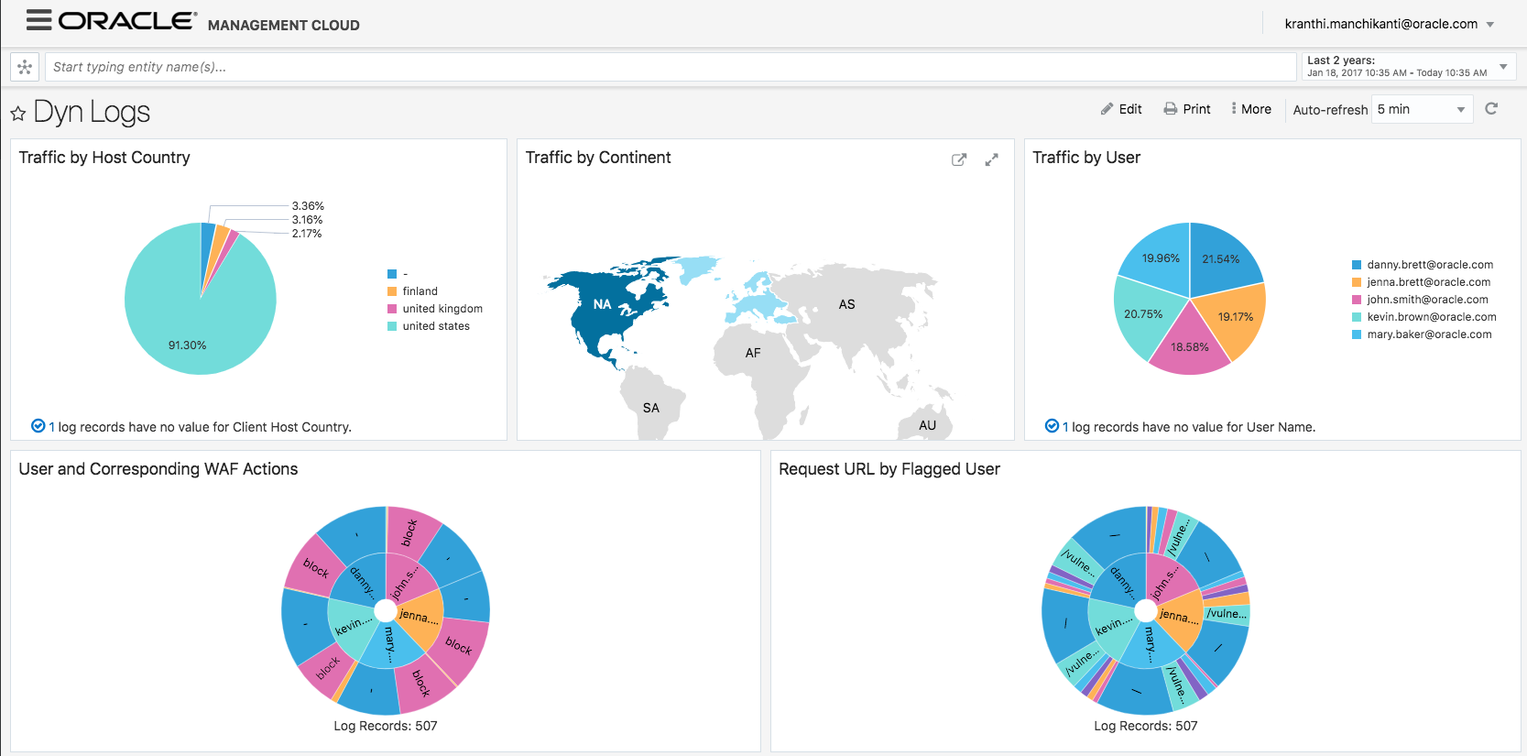
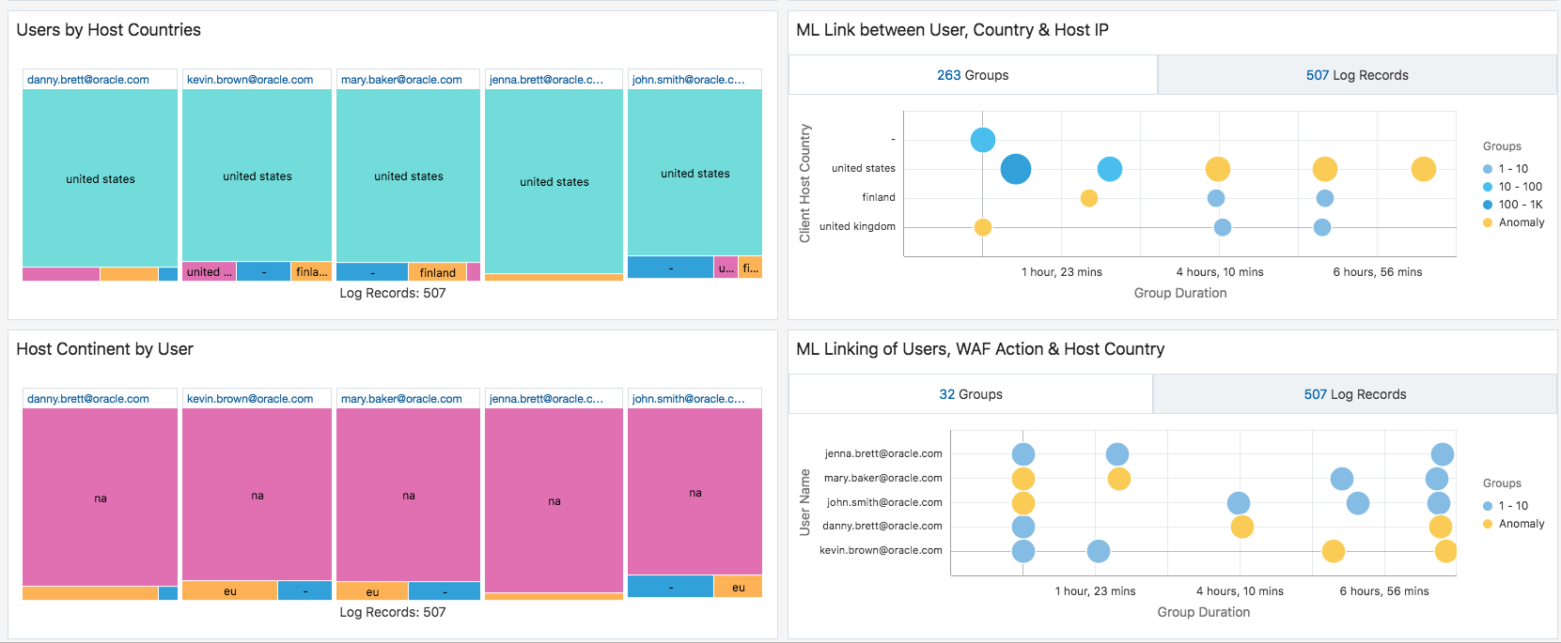

Slide 7
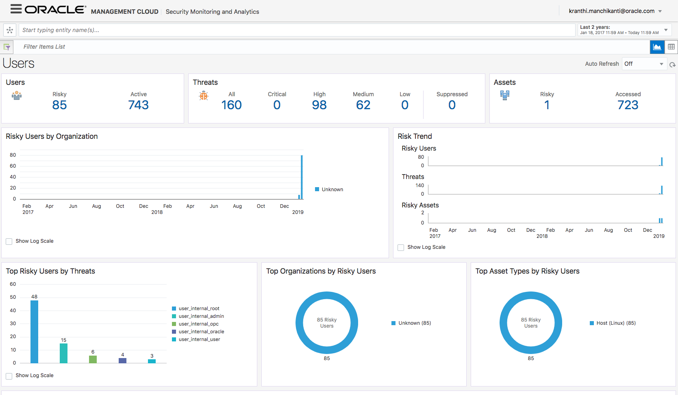

Slide 8
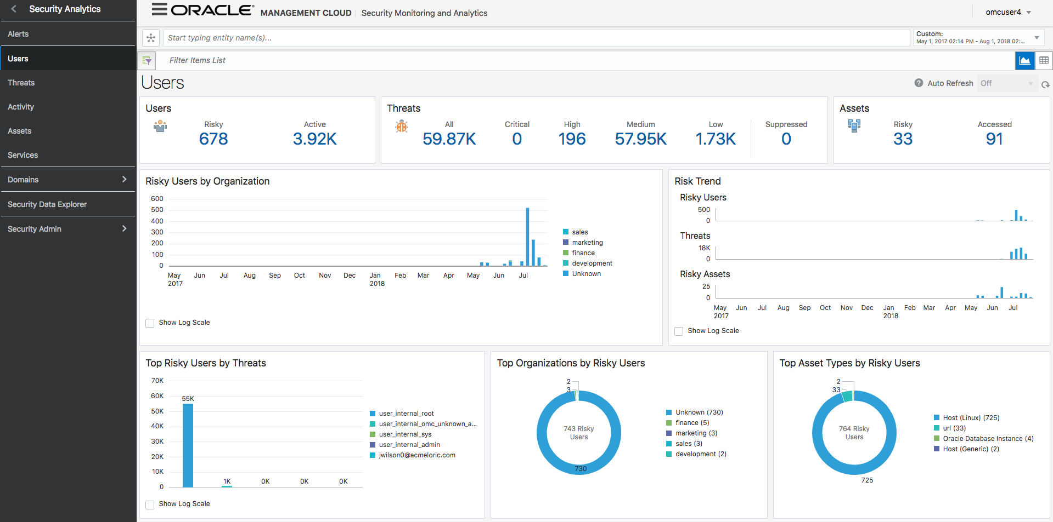
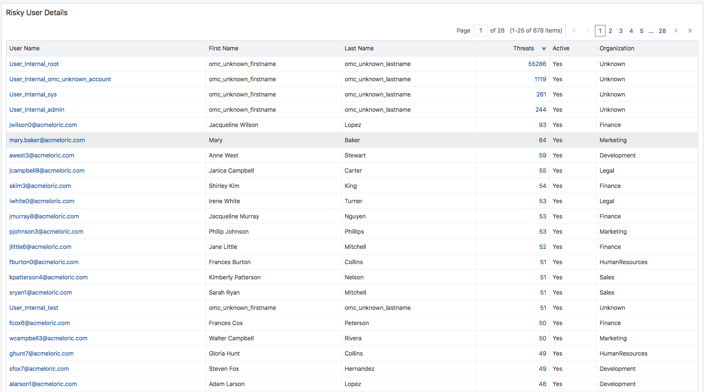

Slide 9
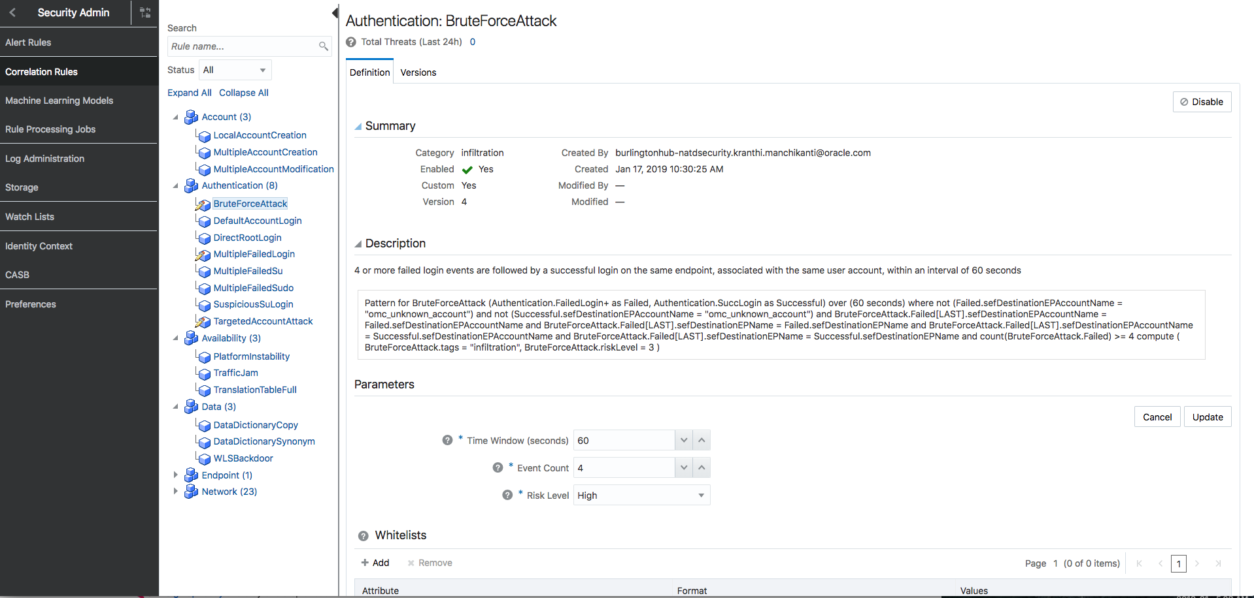

Slide 10
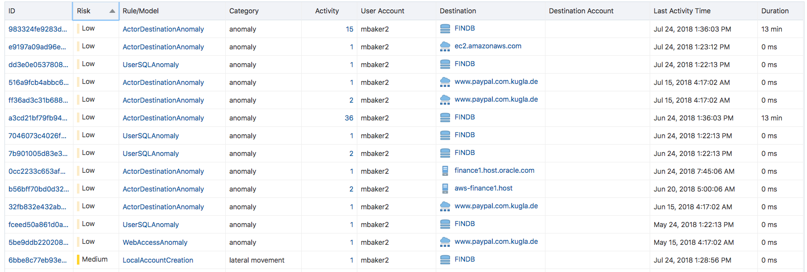

Slide 12

OMC + Dyn: Perimeter Protection and Internal Visibility
Perimeter Protection
Internal Visibility
Dyn WAF
Cloud Tenancy
Security Monitoring & Analytics
Mary Baker
Marketing Executive
Mary Baker
Marketing Executive
Log Analytics

